Slide 1
High-Resolution Image Synthesis with Latent Diffusion Models(LDM)
2022158034 조장혁

Slide 2
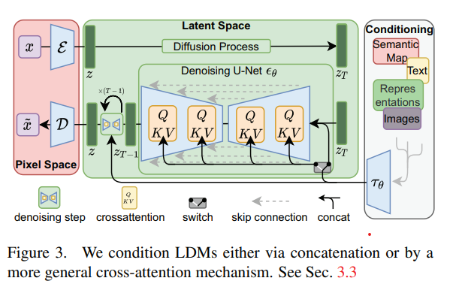

Slide 3



Slide 4


Slide 5
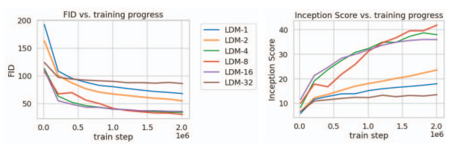


Slide 6



Slide 7
